Slide 1
Tutorial 6
Ziren
u4975835@anu.edu.au
Thursday 10 am to 11am
CBE 3.09

Slide 2
Hints for Assignments
Please remember to finish each question!
Some questions have two parts, please finish both of them.
No half mark, as it is only 0.5 for each question. Hence, for questions with two parts, if you incorrectly answered one part, you will lose all marks.

Slide 3
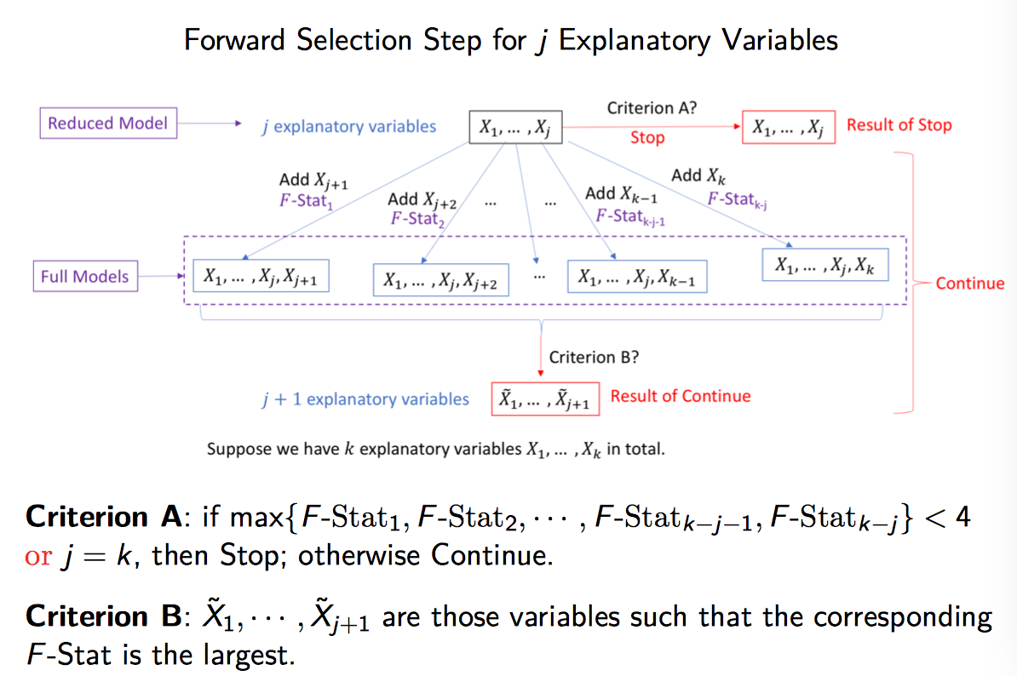
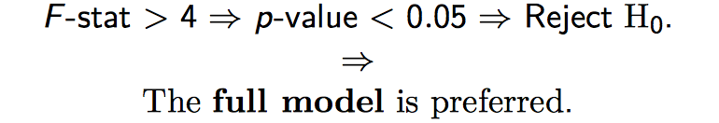
Forward Selection

Slide 4
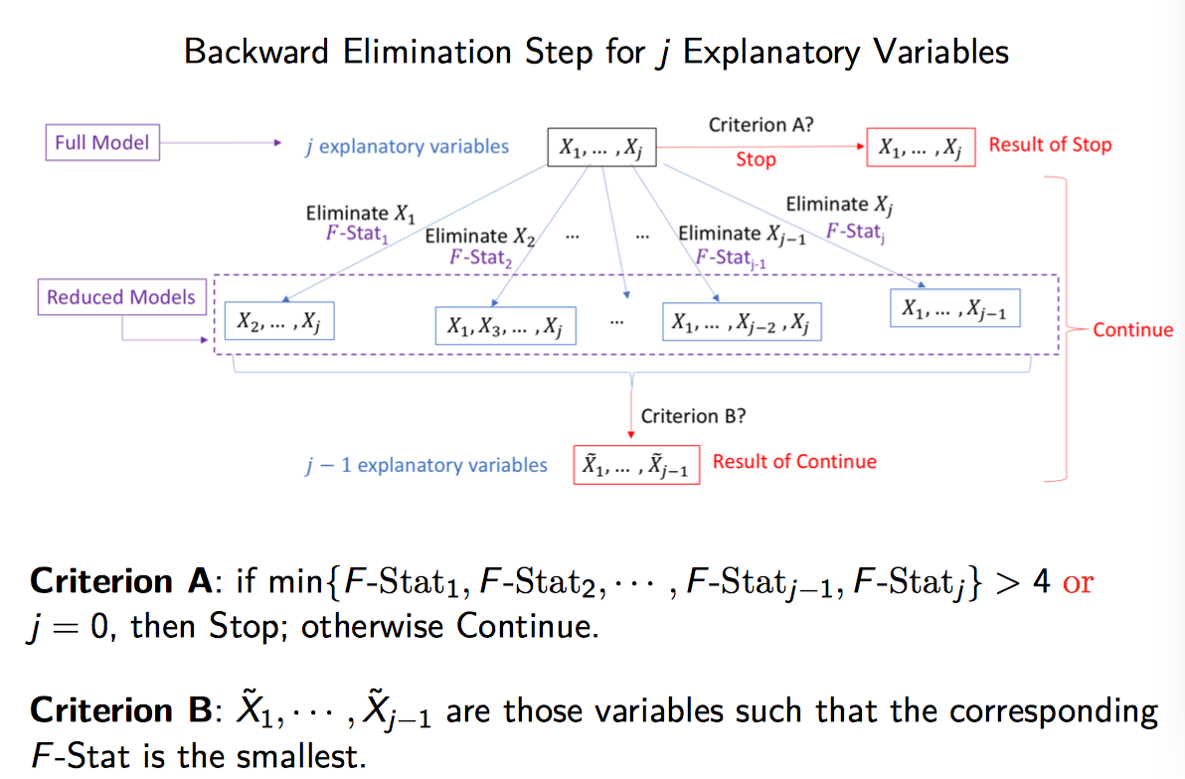
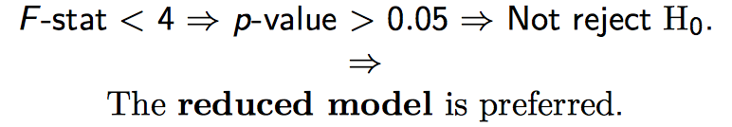
Backward Elimination

Slide 5
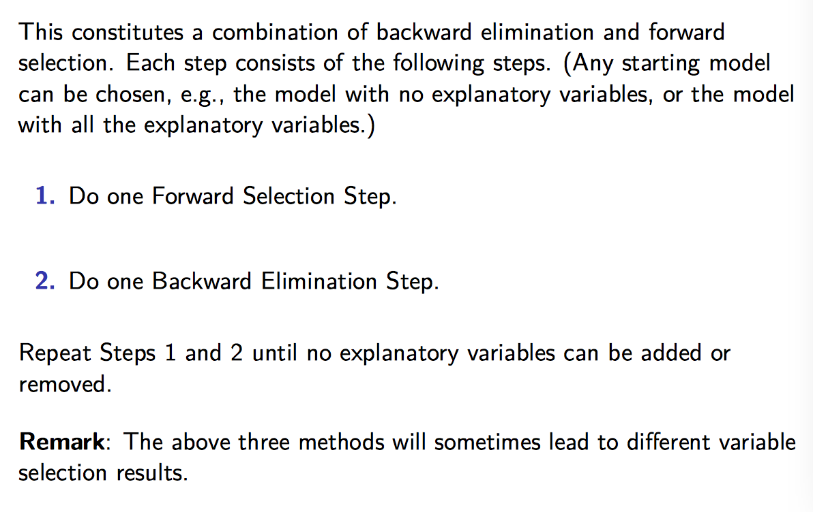
Stepwise Selection

Slide 6
Question 1
Data in one early study designed to explore this issue came from 5 Standard Metropolitan Statistical Areas (SMSA) in the United States, obtained for the years 1959-1961. Total age-adjusted mortality from all causes (mortality), in deaths per 100,000 population, is the response variable. The explanatory variables include mean annual precipitation (in inches); median number of school years completed, for persons of age 25 years or older; percentage of 1960 population that is nonwhite; relative pollution potential of oxides of nitrogen, NO_{x}; and relative pollution potential of sulphur dioxide, SO₂. “Relative pollution potential” is the product of the tons emitted per day per square kilometre and a factor correcting for SMSA dimension and exposure.

Slide 7
Question 1
Is there evidence that mortality is associated with either of the pollution variables, after the effects of the climate and socioeconomic variables are accounted for? To answer this question you must first decide upon an appropriate model.
Find a 95% confidence interval for the mean mortality for a city with the following characteristics precipitation=30, education=10, nonwhite=20, NO_{x}=1, and SO₂=1.
Conduct an appropriate hypothesis test(s) to determine whether the variables education and nonwhite provide important information about mortality, over and above what is explained by precipitation, NO_{x} and SO₂.

Slide 8
Question 2
The file “birds” contains measurements on breeding pairs of land bird species collected from 16 islands around Britain over the course of several decades. For each species, the dataset contains average time of extinction on those island where it appeared; the average number of nesting pairs; the size of the species (large or small); and the migratory status of the species (migrant or resident). It is expected that species with larger numbers of nesting pairs will tend to remain longer before becoming extinct.
Is average extinction time influenced by nesting pairs, size or migratory status?
Does effect of size differ depending on the number of nesting pairs?

Slide 9
Question 3
Blood-Brain Barrier. Please use “install.packages(‘Sleuth3’)” and “library(Sleuth3)” to call the dataset in this problem. Using the data stoblack in the object “case1102” of the R library “Sleuth3”, perform the following variable-selection techniques to find a subset of the covariates-days after inoculation (Days), tumor weight (Tumor), weight loss (Loss), initial weight (Weight), and sex (Sex)-for explaining log of the ratio of brain tumor antibody count (Brain) to liver antibody count (Liver).
Forward selection by using F-statistic;
Backward elimination by using F-statistic;
Stepwise selection by using F-statistic. Are the above results the same?

